Slide 1
MECM Design For UPF integration (Traffic Rules & DNS Redirect )

Slide 2
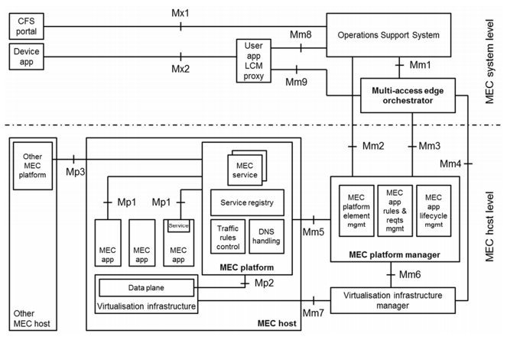
EdgeGallery Architecture Alignment with ETSI MEC (Management Part) – Solution1 (mm3)
Management
Management
Common Services
AppO
Common Services
AppO
APM
APM
1. APPLCM table has to be renamed to MEPM table and add an entry of appRules in table(ip and port) in Inventory
2. APPO sends instantiate request to LCM controller
3. LCM Controller will instantiate app
4. LCM Controller will call AppRules to configure AppD
Platform Manager
Platform Manager
Security Services
Security Services
Inventory
Logging
Logging
Infra Manager
Infra Manager
Placement
Placement
Policy
DB etc.
DB etc.
MEPM
MEPM
AppLCM
AppLCM
AppRules
AppRules
Element management
Element management
LCM Controller
LCM Controller
K8s plugin
K8s plugin
Future plugin
Future plugin
K8s/Future VIM
K8s/Future VIM
Code change
New module

Slide 3
EdgeGallery Architecture Alignment with ETSI MEC (Management Part) – Solution2 (mm3)
Management
Management
Common Services
AppO
Common Services
AppO
APM
APM
1. APPLCM table has to be renamed to MEPM table and add an entry of appRules in table(ip and port) in Inventory
2. APPO sends instantiate request to LCM controller
3. LCM Controller will instantiate app
4. APPO will call AppRules to configure AppD
5. Appo Saves AppDRulesModel in Inventory
Platform Manager
Platform Manager
Security Services
Security Services
Inventory
Logging
Logging
Infra Manager
Infra Manager
Placement
Placement
Policy
DB etc.
DB etc.
MEPM
MEPM
AppLCM
AppLCM
AppRules
AppRules
Element management
Element management
LCM Controller
LCM Controller
K8s plugin
K8s plugin
Future plugin
Future plugin
K8s/Future VIM
K8s/Future VIM
Code change
New module

Slide 4
EdgeGallery Architecture Alignment with ETSI MEC (Management Part) – (mm2)
Management
Management
Common Services
AppO
Common Services
AppO
APM
APM
1. APPLCM table has to be renamed to MEPM table and add an entry of appRules in table(ip and port) in Inventory
2. MECM-fe sends request to APPO to configure trafficrules/dns rules
3. APPO calls AppRules to configure AppD
Platform Manager
Platform Manager
Security Services
Security Services
Inventory
Logging
Logging
Infra Manager
Infra Manager
Placement
Placement
Policy
DB etc.
DB etc.
MEPM
MEPM
AppLCM
AppLCM
AppRules
AppRules
Element management
Element management
LCM Controller
LCM Controller
K8s plugin
K8s plugin
Future plugin
Future plugin
K8s/Future VIM
K8s/Future VIM
Code change
New module

Slide 5
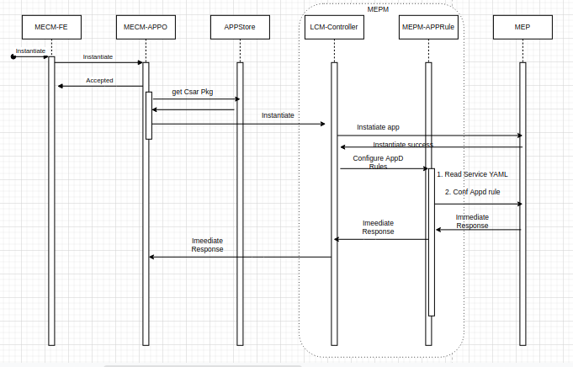
AppDRules Configuration – Addition - Solution1

Slide 6
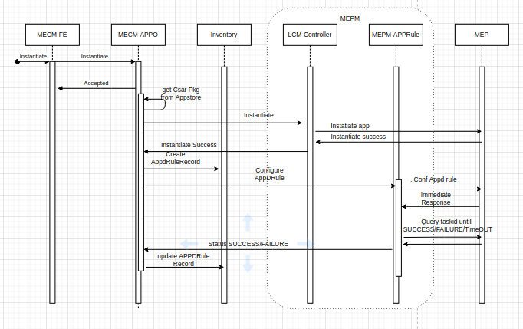
AppDRules Configuration – Addition - Solution2

Slide 7
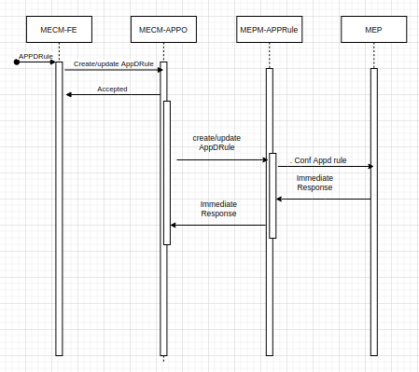
Traffic/DNS Rule Configuration via MECM-FE - Solution1

Slide 8
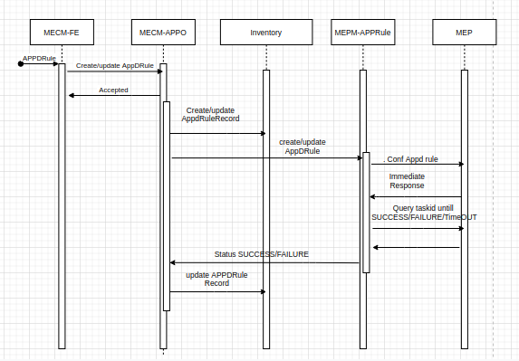
Traffic/DNS Rule Configuration via MECM-FE - Solution2

Slide 9
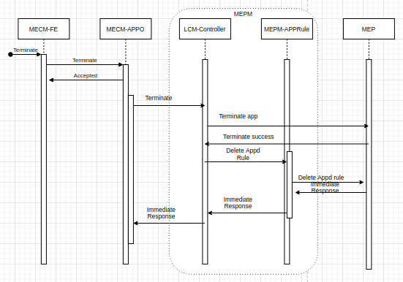
AppDRules Configuration – Delete - Solution1

Slide 10
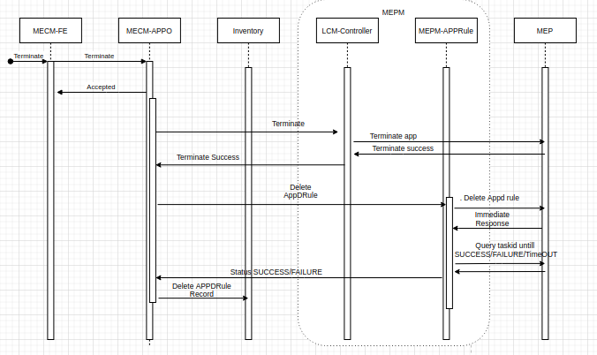
AppDRules Configuration – Delete - Solution2

Slide 11
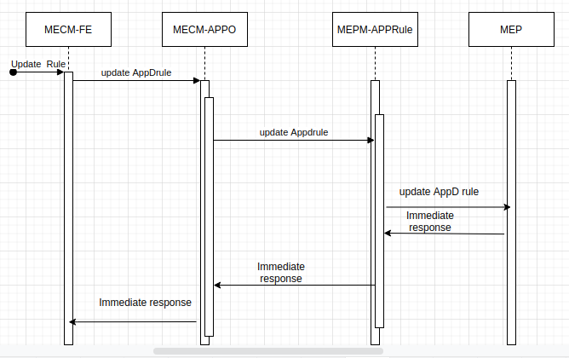
Delete/Update Specific Traffic/DNS Rule Configuration via MECM-FE - Solution1

Slide 12
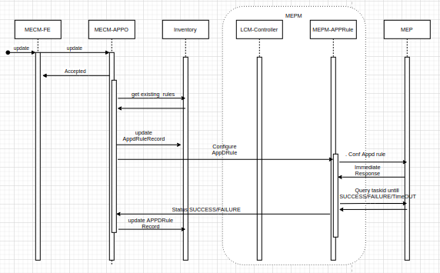
Delete/Update Specific Traffic/DNS Rule Configuration via MECM-FE - Solution2

Slide 13
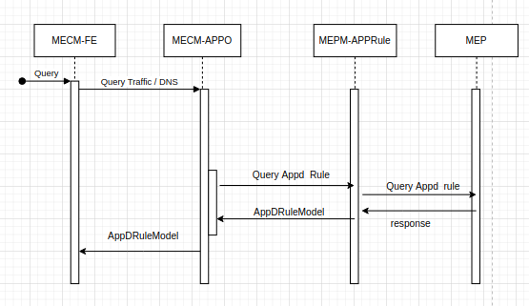
Traffic/DNS Rule Configuration - Query -Solution1

Slide 14
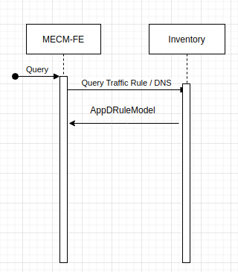
Traffic/DNS Rule Configuration - Query – Solution2

Slide 15
AppDRuleModel：
AppD Rules
Parameter | M is required; C is required for conditions; O is optional。 | Description
appTrafficRule | 0..N | TrafficRule Descriptor. Maximum of 16 traffic Rules.
>trafficRuleId | M | （String）Traffic Rule Identifier (Unique). Value Range：1~63 bytes
>filterType | M | （String）Indicates Filtering type. Definition of filter per FLOW or PACKET. Enumeration: FLOW , PACKET.
>priority | M | （Integer) Priority of this traffic rule. If traffic rule conflicts, the one with higher priority take precedence. Value Range: 1~255
>action | M | （String）The action of the MEC host data plane when a packet matches the trafficFilter. Enumeration: DROP, PASSTHROUGH.
>trafficFilter | M | （Array）This type represents the traffic filter.
>>srcAddress | C | （Array Of Strings）Source IP address, IP address string supports mask, IP_V4 defaults to /32, IP_V6 defaults to /128. e.g. [“192.168.1.1/32”, “172.18.0.0/24”, “10.0.0.0/16”]
>>srcPort | C | （Array Of Strings） The array element supports a single port number, or a port number range. e.g. [“80”, “2000-3000”]
>>dstAddress | C | （Array Of Strings） Destination IP address, IP address string supports mask, IP_V4 defaults to /32, IP_V6 defaults to /128. e.g.[“192.168.1.1/32”, “172.18.0.0/24”, “10.0.0.0/16”]
>>dstPort | C | （Array Of String） The array element supports a single port number, or a port number range. [“80”, “2000-3000”]
>>protocol | C | （Array Of String）Specify the protocol of the traffic filter. the value range of N is 0-255. use protocol standard defined number: N. Note: If Protocol and Port conflict (for example: the protocol is L3 or below, but the L4 port is configured at the same time), UPF will give priority to the protocol, you can ignore the port configuration or check the error (for example: the protocol is ICMP, then the port is configured It didn't work). If the Protocol is not configured, it is determined by the action whether it is "full protocol passed" or "full protocol rejected
>>qci | O | （Integer）Used to match all packets that have the same Quality Class Indicator (QCI)
>>dscp | O | （Integer）Used to match all IPv4 packets that have the same Differentiated Services Code Point (DSCP)
>>tc | O | （Integer) Used to match all IPv6 packets that have the same Traffic Class.

Slide 16
AppD Rules (Cont)
AppDRuleModel：
Parameter | M is required; C is required for conditions; O is optional。 | Description
appDNSRule | 0..N | DNS Rule Descriptor. Maximum of 32 Rules.
>dnsRuleId | M | （String）DNS Rule Identifier (Unique). Value Range：1~63 bytes
>domainName | M | (String）FQDN Domain name Value Range：1~63 bytes
>ipAddressType | M | （ENUM）IPAddress Type. IPv4 or IPv6.
>ipAddress | M | （String）IP address.
>ttl | O | （Int）Validity period of DNS record resolution. Range/l 1 ~ 4294967295 in seconds. Default value is 86400.

Slide 17
Operation Progress Model
Parameter | M is required; C is required for conditions; O is optional。 | Description
taskId | M | (String)TaskID of adding a AppD resource. This would be allocated by MEP.
appInstanceId | M | (String) Application Instance Id.
configResult | M | （String）Operation result. It can be SUCCESS, FAILURE or PROCESSING
configPhase | M | (String）Percentage of progress of operation.
detailed | M | （String) Details about the AppD resource Operation.
Note:
1. On Immediate Response, if operation is success then this operation Progress model would be returned as response. (201 Created)
2. On Failure, operation failure model would be send as response.
3. Query Task status would also return this as response.

Slide 18
Operation Failure Model
Parameter | M is required; C is required for conditions; O is optional。 | Description
type | M | (String)Error type .
title | M | (String) Failure Title.
status | M | （Int）Error status
detail | M | (String）Error details and description

Slide 19
MEPM Interfaces – Solution1
Method | API | RequestBody | Response
POST | /mepm/v1/app_instances/{app_instance_id}/appd_configuration | csar pkg/MainServiceTemplate | 201 Created: Operation Progress Model 400 Bad Request: 403 Forbidden: 404 Not Found: Operation Failure Model
PUT | /mepm/v1/app_instances/{app_instance_id}/appd_configuration | AppDRuleModel | 201 Created: Operation Progress Model 400 Bad Request: 403 Forbidden: 404 Not Found: Operation Failure Model
DELETE | /mepm/v1/app_instances/{app_instance_id}/appd_configuration | None | 201 Created: Operation Progress Model 400 Bad Request: 403 Forbidden: 404 Not Found: Operation Failure Model
GET | /mepm/v1/app_instances/{app_instance_id}/appd_configuration | None | AppDRuleModel
POST PUT | /mepm/v1/app_instances/{app_instance_id}/traffic_rules | AppDRuleModel | 201 Created: Operation Progress Model 400 Bad Request: 403 Forbidden: 404 Not Found: Operation Failure Model
POST PUT | /mepm/v1/app_instances/{app_instance_id}/dns_rules | AppDRuleModel | 201 Created: Operation Progress Model 400 Bad Request: 403 Forbidden: 404 Not Found: Operation Failure Model

Slide 20
MEPM Interfaces – Solution1 - Continued
Method | API | RequestBody | Response
GET | /mepm/v1/app_instances/{app_instance_id}/traffic_rules | None | AppDRuleModel
GET | /mepm/v1/app_instances/{app_instance_id}/dns_rules | None | AppDRuleModel
DELETE | /mepm/v1/app_instances/{app_instance_id}/traffic_rules | None | Ok/error
DELETE | /mepm/v1/app_instances/{app_instance_id}/dns_rules | None | Ok/error

Slide 21
MECM-APPO Interfaces - Solution1
Method | API | Request | Response
POST PUT | /appo/v1/tenants/{tenant_id}/app_instances/{app_instance_id}/traffic_rules | AppDRuleModel | ok/error
POST PUT | /appo/v1/tenants/{tenant_id}/app_instances/{app_instance_id}/dns_rules | AppDRuleModel | ok/error
GET | /appo/v1/tenants/{tenant_id}/app_instances/{app_instance_id}/traffic_rules | None | AppDRuleModel
GET | /appo/v1/tenants/{tenant_id}/app_instances/{app_instance_id}/dns_rules | None | AppDRuleModel
DELETE | /appo/v1/tenants/{tenant_id}/app_instances/{app_instance_id}/traffic_rules | None | Ok/error
DELETE | /appo/v1/tenants/{tenant_id}/app_instances/{app_instance_id}/dns_rules | None | Ok/error
GET | /appo/v1/tenants/{tenant_id}/app_instances/{app_instance_id}/appd_configuration | None | AppDRuleModel
DELETE | /appo/v1/tenants/{tenant_id}/app_instances/{app_instance_id}/appd_configuration | None | ok/error
PUT | /appo/v1/tenants/{tenant_id}/app_instances/{app_instance_id}/appd_configuration | AppDRuleModel | ok/error

Slide 22
Inventory Interfaces - Solution2
Method | API | RequestBody | Response
GET | /inventory/v1/app_instances/{app_instance_id}/appd_configuration | Nome | AppDRuleModel
POST | /inventory/v1/app_instances/{app_instance_id}/appd_configuration | AppDRuleModel | ok/error
DELETE | /inventory/v1/app_instances/{app_instance_id}/appd_configuration | None | ok/error
PUT | /inventory/v1/app_instances/{app_instance_id}/appd_configuration | AppDRuleModel | ok/error

Slide 23
MEPM Interfaces - Solution2
Method | API | RequestBody | Response
POST PUT | /mepm/v1/app_instances/{app_instance_id}/traffic_rules | AppDRuleModel | ok/error
POST PUT | /mepm/v1/app_instances/{app_instance_id}/dns_rules | AppDRuleModel | ok/error
GET | /mepm/v1/app_instances/{app_instance_id}/traffic_rules | None | AppDRuleModel
GET | /mepm/v1/app_instances/{app_instance_id}/dns_rules | None | AppDRuleModel
DELETE | /mepm/v1/app_instances/{app_instance_id}/traffic_rules | None | ok/error
DELETE | /mepm/v1/app_instances/{app_instance_id}/dns_rules | None | ok/error
POST | /inventory/v1/app_instances/{app_instance_id}/appd_configuration | AppDRuleModel | ok/error
DELETE | /inventory/v1/app_instances/{app_instance_id}/appd_configuration | None | ok/error
PUT | /inventory/v1/app_instances/{app_instance_id}/appd_configuration | AppDRuleModel | ok/error

Slide 24
MECM-APPO Interfaces - Solution2
Method | API | Request | Response
POST PUT | /appo/v1/tenants/{tenant_id}/app_instances/{app_instance_id}/traffic_rules | AppDRuleModel | ok/error
POST PUT | /appo/v1/tenants/{tenant_id}/app_instances/{app_instance_id}/dns_rules | AppDRuleModel | ok/error
GET | /appo/v1/tenants/{tenant_id}/app_instances/{app_instance_id}/traffic_rules | None | AppDRuleModel
GET | /appo/v1/tenants/{tenant_id}/app_instances/{app_instance_id}/dns_rules | None | AppDRuleModel
DELETE | /appo/v1/tenants/{tenant_id}/app_instances/{app_instance_id}/traffic_rules | None | Ok/error
DELETE | /appo/v1/tenants/{tenant_id}/app_instances/{app_instance_id}/dns_rules | None | Ok/error
DELETE | /appo/v1/tenants/{tenant_id}/app_instances/{app_instance_id}/appd_configuration | None | ok/error
PUT | /appo/v1/tenants/{tenant_id}/app_instances/{app_instance_id}/appd_configuration | AppDRuleModel | ok/error

Slide 25
Open points
1. How to check application state whether it is in running state or not?
2. Solution1 or Solution2 for mm3?
3. Whether we need to have seperate API’s for traffic rules and dns rules for mm2?
4. Delete/update specific traffic rule from MECM-FE should be allowed or not?
5. Update only traffic rule should have data of dns rule as well?
6. Activation/Deactivation of DNS rules/Trafficrules is currently supported

